Slide 1

Research Question –
Tutorial Presentation for Feedback
Date: 24-11-2025
Group Name: Group A 101 Name of Student Presenting: Kiran Dennis Kotteparambil Thomas

Slide 2
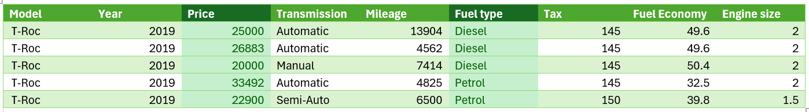
1. For our research question, we will use the price and fuel type columns.
2. Sample dataset
3. The dataset has 15157 rows and 9 columns.
Here is a sample of our dataset:

Slide 3
This dataset is interesting to us because : This dataset is interesting to us because it provides used car data that allows us to determine prices based on factors such as age, mileage, engine size, fuel type, fuel economy and transmission.
From the column headings in your dataset choose ONE independent * and ONE dependent variable .
Our Independent variable is: fuel type
This Independent variable datatype is (select one): Nominal/categorial
Our Dependent variable is: price
This Dependent variable datatype is (select one): Interval/measurement data
Dataset ID: DS181 Filename: vw.csv
*For comparison of two nominal variables and for comparison of proportions you use two (or more) independent variables (see next slide)
Notes:
Before specifying your Research Question you must define the type of data you are analysing. Are the variables you select interval data (measurement data you can divide, multiple, etc), OR are they ordinal (there is a definite order but the intervals between each variable are not necessarily equal, or the terms might be subjective like in a likert scale); OR are they just categorical/nominal (Items such as film names, cities, etc., that you can count numbers of occurrences? You also need to understand whether the variable is either dependent or independent and this will vary according to the context. Independent variables may cause an effect, whereas the dependent variable might be effected by the independent variable. Check the lecture notes on the RQ for more information and examples.
You will get only one opportunity to present your Research Question ahead of the submission date. Have your questions ready, and be ready to take notes on feedback.

Slide 4
Template² : Interval/Ordinal vs Nominal. data “Is there a difference in the mean price between petrol and diesel fuel type in the UK’s used car market for Volkswagen cars manufactured from 2000 to 2020”.
1. Null hypothesis (H₀): There is no difference in the mean price between petrol and diesel fuel type in the UK’s used car market for Volkswagen cars manufactured from 2000 to 2020.
2. Alt hypothesis (H₁): There is a difference in the mean price between petrol and diesel fuel fuel type in the UK’s used car market for Volkswagen cars manufactured from 2000 to 2020.
We have statistical significance [p-value = < 0.05]
"We reject the null hypothesis".
Our Research Question is
¹Correlation (Analysis of how ordinal/interval dependent var correlates to an ordinal/interval independent variable)
²Comparison of means (or medians): Analysis of the difference between the mean (or median) value of a characteristic shared by members of two different populations.
³Comparison of proportions: Analysis of the difference in proportions of a characteristic shared by members of two different populations.

Slide 5
Visualization and Analysis –
Tutorial Presentation for Feedback
Date:
Group Name: Group A 101 Name of Student Presenting: Kiran Dennis Kotteparambil Thomas

Slide 6
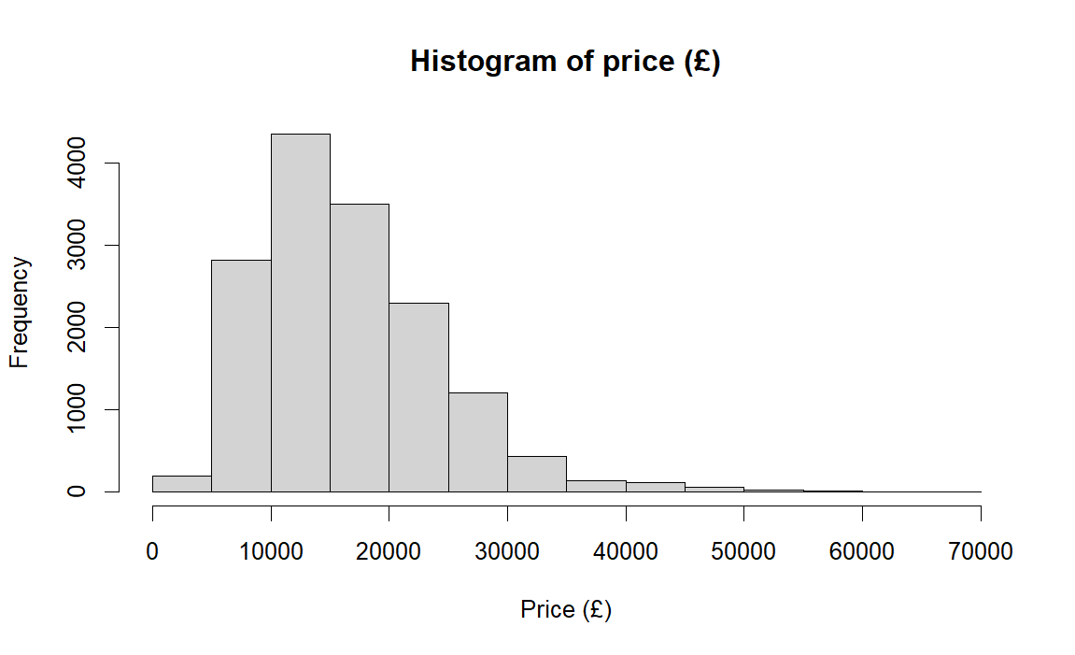
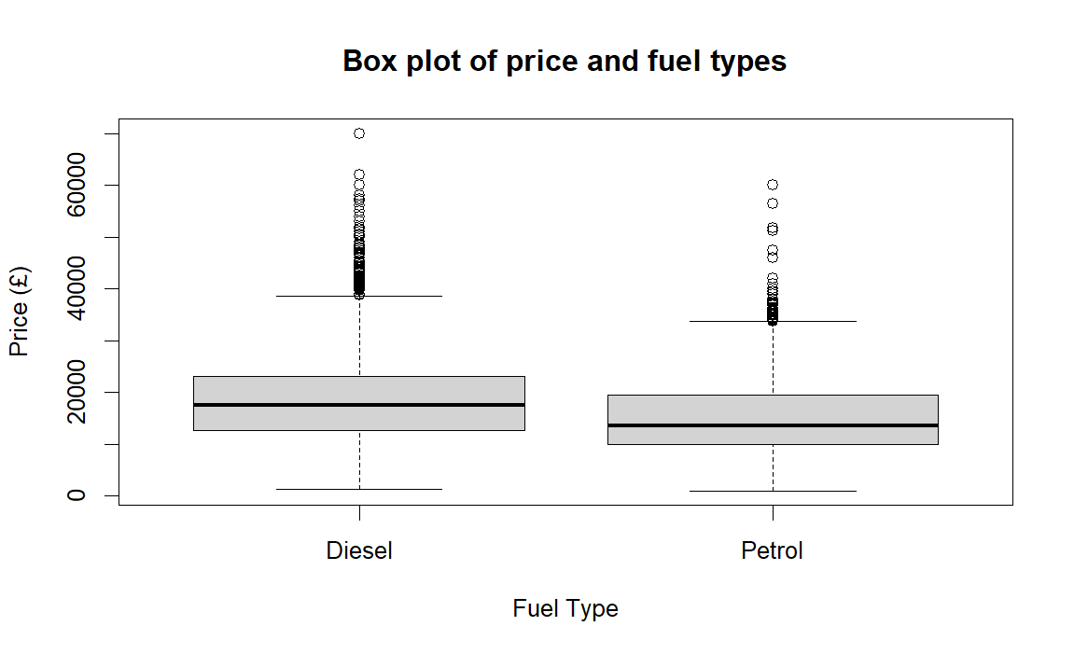
2. Where your research question asks about Comparison of means/medians: Include two plots
Comparison of means (or medians) analyses the difference between the mean (or median) value of a characteristic shared by members of two (or more) different populations/values.

Slide 7
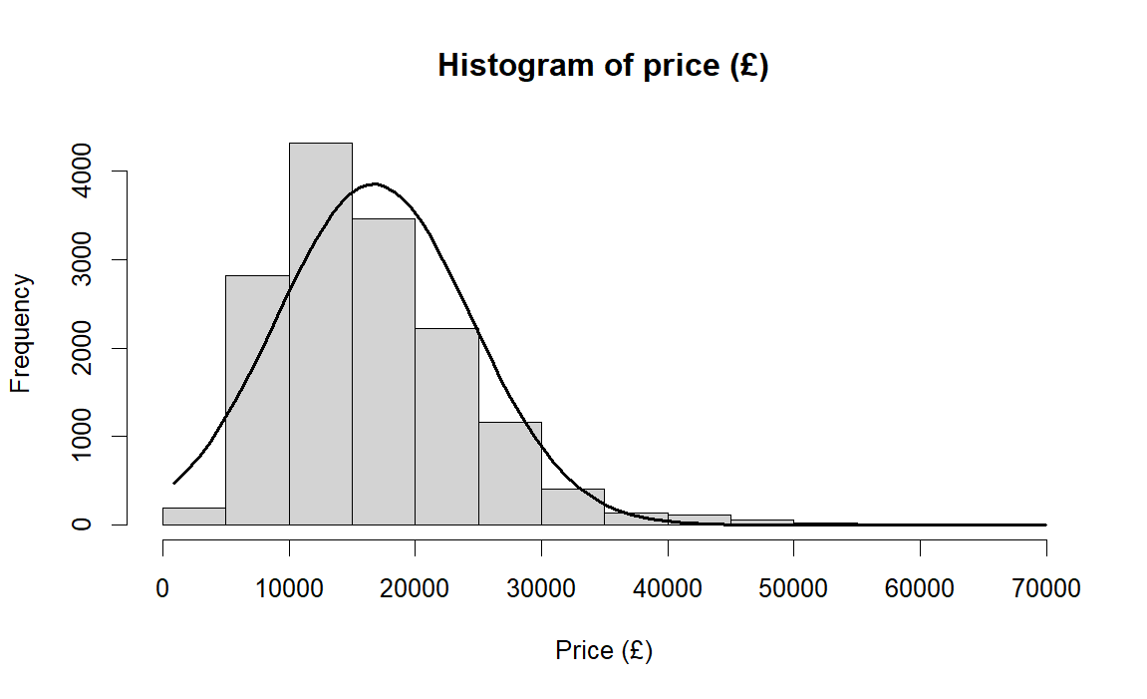
Here is a Histogram showing the frequencies of our dependent variable to include the normal curve overlay (shown in blue).
Our RQ asks about Differences in means/ medians
The normal curve overlay does not follow the shape of the underlying data, so we use the non-parametric test that does not assume normality: Wilcoxon also known as the Mann Whitney U Test.
7

Slide 8
R Script and Results (For ALL types of test) – The Analysis
PRE 7COM1079-2022 Student Group No: ?????
8
hist(vw$price, xlab = "Price (£)",
main = "Histogram of price (£)")
summary(vw$price)
vw2 <- vw[vw$fuelType %in% c("Diesel", "Petrol"), ]
wilcox.test(vw2$price ~ vw2$fuelType)
boxplot(vw2$price ~ vw2$fuelType, xlab = "Fuel Type",
ylab = "Price (£)",
main = "Box plot of price and fuel types")
hist(vw2$price, xlab = "Price (£)",
main = "Histogram of price (£)")
x_values <- seq(min(vw$price), max(vw$price), length = 100)
y_values <- dnorm(x_values, mean = mean(vw2$price), sd = sd(vw2$price))
y_values <- y_values * diff(hist_data$mids[1:2]) * length(vw2$price)
lines(x_values, y_values, lwd = 2)
Notes:
8

Slide 9
What does the result actually mean in the wider context of learning something useful / answering your RQ?
Based on the statistical analysis, we can state that the car prices are higher for diesel cars compared to the petrol prices for the Volkswagen cars manufactured from 2000 to 2020.
Customers tend to lean towards more fuel-efficient options thus diesel cars have higher demand as a result, their average price is higher than petrol cars.

